Slide 1
INTRODUCTION TO LESSON STUDY
Notes:
This presentation will take approximately 30 minutes. We have provided talking points in the notes section of each slide.
Welcome everyone. [Start by sharing how you came to learn about lesson study and any personal experiences you may have (just a couple of minutes). [Based on this you are excited to share what you have learned about lesson with your colleagues]

Slide 2
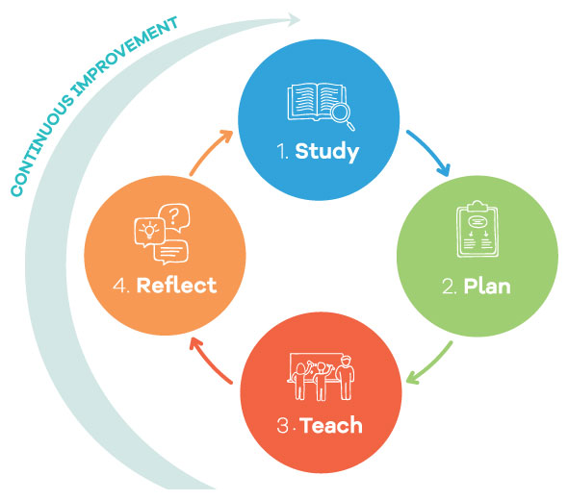
What is Lesson Study?
Lesson Study is an inquiry cycle that supports teachers to experiment, observe and improve. As teachers work together to study student learning, schools become places where both students and teachers are passionate about learning.
Notes:
Lesson study is an approach to instructional improvement that has spread rapidly in North America since its introduction from Japan in 1999. Lesson study is a simple idea.If you want to improve instruction, what could be more obvious than collaborating with fellow teachers to plan instruction and examine its impact on students?

Slide 3
Teaching Gap
Improving something as complex and culturally embedded as teaching requires the efforts of all the players, including students, parents, and politicians. But teachers must be the primary driving force behind change. They are best positioned to understand the problems that students face and to generate possible solutions.
James Stigler and James Hiebert, The Teaching Gap, 1999, p.13
Notes:
According to the Teaching Gap by James Stigler and James Hiebert ---[read above quote]
While lesson study may be a simple idea – STUDY, PLAN,TEACH, REFLECT, it is a complex process. Lesson study asks teachers to work together to challenge and build one another’s knowledge of subject matter and of student thinking, and to observe in one another’s classrooms. It asks teachers to focus on student thinking, rather than on teaching moves, and to question and investigate the impact of lessons–rather than assuming that lessons work because they are from “proven” or mandated.
Lesson study allows teachers to be the primary driving force behind change.

Slide 4
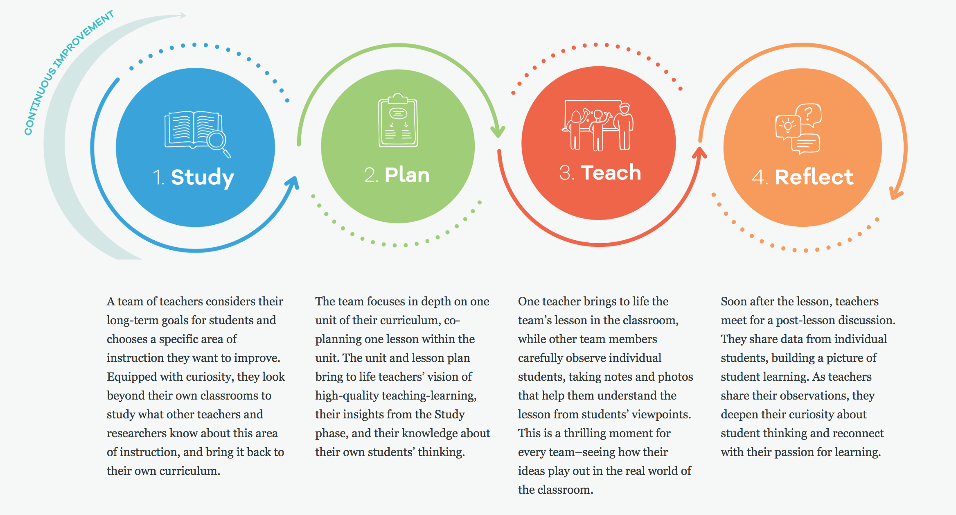
The Lesson Study Process
Notes:
Let’s look at how lesson study works:
[Allow this slide to remain on the screen and ask teachers to read the process steps, taking notes about what they think is interesting about this process, and what might be challenging? Allow time to discuss with a partner or in groups. Allow teachers to share some responses].
Optional – watch lesson study videos of the four phases from the website: www.lessonresearch.net
2. [Ask the same pairs/groups of teachers to discuss how lesson study differs from other kinds of professional development they have been part of? Allow teachers to share out differences they noticed]

Slide 5
How Does Lesson Study Differ from Traditional Teacher Professional Development?
Notes:
Does this align with what you discussed?
One size fits all professional development rarely meets the needs of all teachers within a school or district. In lesson study, teachers bring their own pressing questions to the table and seek out answers from one another, from outside specialists and research, and from careful study of students during a lesson that incorporates teachers’ collective knowledge.
Optional – watch three videos under What Educators Say About Lesson Study (in About Lesson Study)
Ask teacher to discuss: how often do you have the opportunity to watch and discuss what happens in each other’s classroom? [Discuss and ask teachers to share their responses)

Slide 6
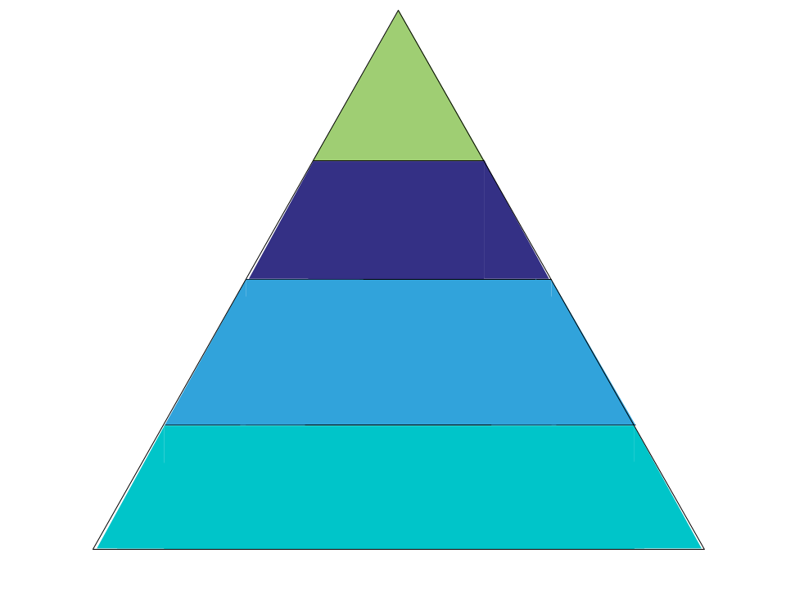
Teachers’ Activities to Improve Instruction?
Choose curriculum,
write curriculum, align curriculum,
write local standards
Plan lessons individually
Plan lessons collaboratively
Watch and discuss each other’s classroom lessons
U.S.
Japan
Notes:
This slide shows how the US and Japan differ in terms of time spent on different types of activities to improve instruction.
As you can see, the triangle of US instructional improvement stands precariously on its tip; we are trying to improve instruction without actually observing and discussing it. In contrast, Japanese instructional improvement rests on a solid base of observation, discussion, and refinement of classroom lessons. Lesson study provides a way to shift emphasis so that our instructional improvement efforts rest on a substantial base of lesson observation and discussion

Slide 7
Three Underlying Principles of Lesson Study:
Learning stance
Shared ownership and responsibility
Emphasis on students, not the teacher
Notes:
There are three underlying principles of lesson study:
A Learning Stance
Lesson study differs from mentoring or coaching as its emphasis on inquiry conducted by equals, and it provides an opportunity for even experts to pose and pursue questions about student thinking.
Shared Ownership and Responsibility
In their work together, group members come to feel that lessons are “our” lesson, not “your” lesson or “my” lesson. Members view every participant as having something valuable to contribute to the group.
Emphasis on Students, Not the Teacher
Lesson study focuses on student learning and development. It provides a rare, and valuable chance for teachers to be in a classroom solely to investigate student learning, unencumbered by the need to manage students or provide instruction.
This idea of emphasis on student, not teacher may be new to you…

Slide 8
Emphasis on Students, Not the Teacher
A U.S. teacher pointed out how lesson study differs from the lesson observation familiar to U.S. teachers:
“In the U.S., if you are being observed, it’s a critique of you. Lesson study focuses on student learning, on student ‘aha’s.’ It takes what we’re doing to a more professional level.”
Notes:
It was for this first year teacher [read slide}

Slide 9
What’s Needed for Lesson Study?
Notes:
What’s needed for lesson study?
[Highlight]
People: Team of 3-6 teachers
Time:12 Hours minimum time commitment
Resources: Funding for substitutes

Slide 10
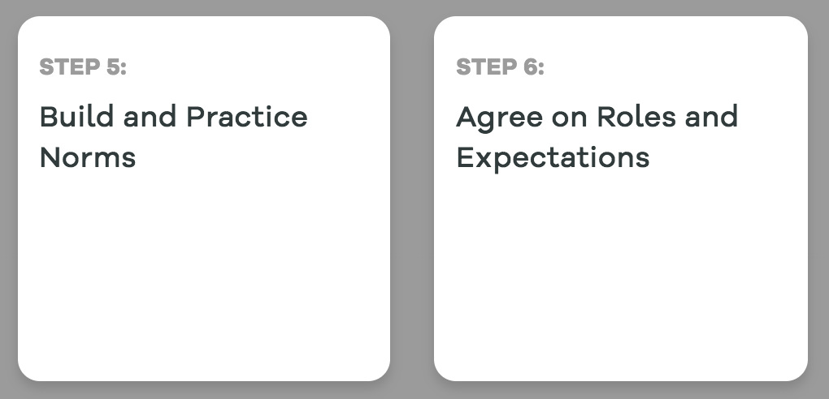
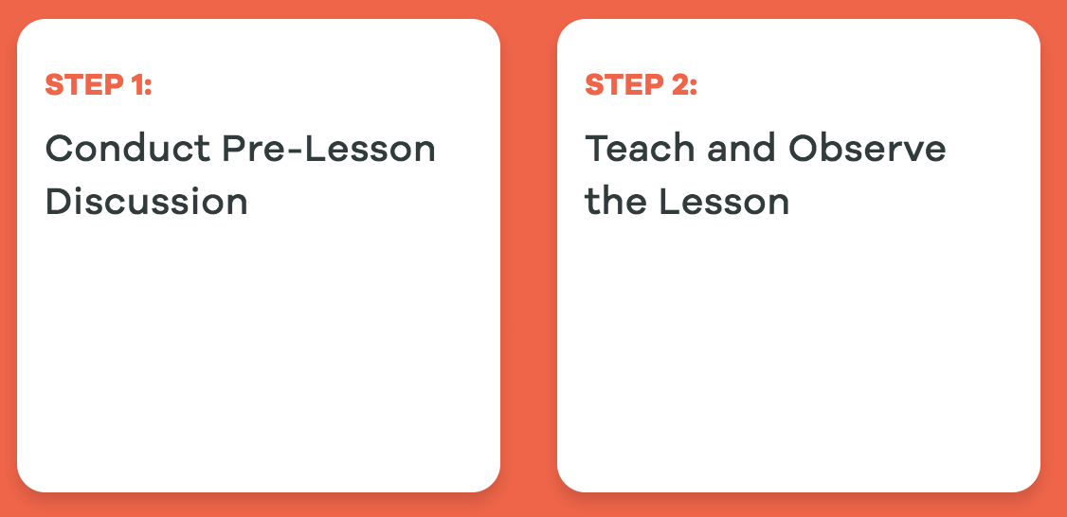
Overview of Lesson Study Steps
Prepare
This 'Prepare' phase is designed mainly for teams new to lesson study or to working together. You can find out how to schedule your work, set norms to support your learning together, and distribute the work load.
Study
A team of teachers asks: What do we want students to learn? What qualities do we want students to develop? They study standards, curriculum, and research related to their goals.
Plan
After analyzing what is known and debating the merits of various approaches, the team plans a lesson within a larger unit to bring to life their goals for student learning and development.
Teach
One team member teaches that lesson, with other group members closely observing and recording student learning.
Reflect
In a post-lesson discussion, team members share their observations of individual students, building a picture of what worked and didn’t. After they reflect on their learning and share their findings.

Slide 11
What Teachers Think about Lesson Study
The opportunity to focus on two to four students’ learning was incredible...You feel like you are in a true research mode.
Elementary Teacher, California
It’s changed how we approach our daily lives. We share everything...We’re more confident sharing – previously I wouldn’t have admitted that I did a lesson that was a flop. There used to be a barrier of feeling like you’re stealing if you share lessons. That barrier is gone now.
Middle School Teacher, Florida

Slide 12
www.lessonresearch.net

